Slide 1

Smart Screen Saver
Team
  Abdelrady Elagamy Abdelrady
  Ali Hussien Ahmed
    IT Department
    Under Supervision of
    Dr. Khaled F.Hussien

Slide 2
بِسْمِ اللهِ الرَّحْمنِ الرَّحِيمِ
قَالُواْ سُبْحَانَكَ لاَ عِلْمَ لَنَا إِلاَّ مَا عَلَّمْتَنَا إِنَّكَ أَنتَ الْعَلِيمُ الْحَكِيمُ
سورة ال عمران(الايه ٣٢)

Slide 3
Implementation Details
Language: C++.
Tool: MS Visual Studio 6.0 IDE , OpenCV.
Application type: Console application.
Prerequisites:
  MS .netFramework2.
  OPenCV Library Installed

Slide 4
Description
An application based on the detection of human face that you pass it a picture & it will detect Faces & Draw (circles,rect,…..)

Slide 5
Details
Application can be divided into four steps
Input Data.
Human face detection.
Object Redraw With Circles

Slide 6
Input Data.
Just type facedetect <Image Path>
& program will do the rest for you
Or you can pass Video input to program like “facedetect bill.avi”

Slide 7
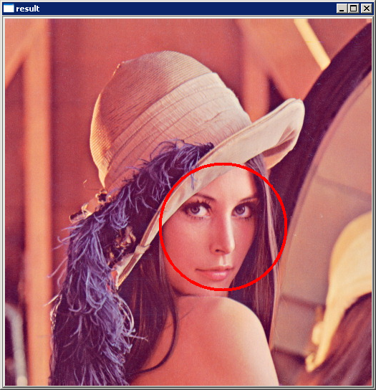
Testing & Results with images

Slide 8
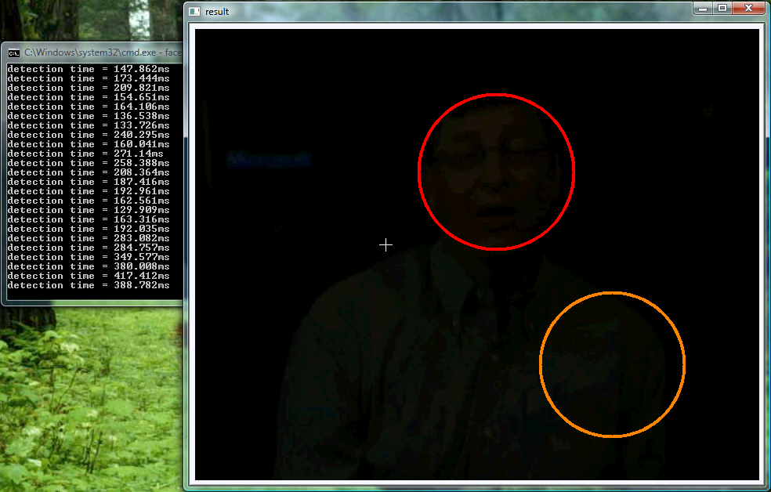
Testing & Results with videos

Slide 9
Human face detection…

Slide 10
Steps Followed
Object Initialization
  Include loading cascades files
Create Memory Storage that contain Images
Detect & Draw images
  Convert Image From RGB to Gray Scale
  Resize Image
  Perform Histogram Equalization On Image
  Detect Faces & draw images With circles

Slide 11
Code:: Main Method
static CvHaarClassifierCascade* cascade = 0;
int main( int argc, char** argv )
{
cascade_name = "../../data/haarcascades/haarcascade_frontalface_alt2.xml";
input_name = argc > 1 ? argv[1] : 0;
cascade = (CvHaarClassifierCascade*)cvLoad( cascade_name, 0, 0, 0 );
storage = cvCreateMemStorage(0);
const char* filename = input_name ? input_name : (char*)"lena.jpg";
IplImage* image = cvLoadImage( filename, 1 );
if( image )
{
detect_and_draw( image );
cvWaitKey(0);
cvReleaseImage( &image );
}
}
Cascades initialization
Create Memory Storage
for data

Slide 12
Code:: Main Method
static CvHaarClassifierCascade* cascade = 0;
int main( int argc, char** argv )
{
cascade_name = "../../data/haarcascades/haarcascade_frontalface_alt2.xml";
input_name = argc > 1 ? argv[1] : 0;
cascade = (CvHaarClassifierCascade*)cvLoad( cascade_name, 0, 0, 0 );
storage = cvCreateMemStorage(0);
const char* filename = input_name ? input_name : (char*)"lena.jpg";
IplImage* image = cvLoadImage( filename, 1 );
if( image )
{
detect_and_draw( image );
cvWaitKey(0);
cvReleaseImage( &image );
}
}
If no file supplied,
take lena.jpg
Load file into
iplImage object
Detect faces & draw Circles

Slide 13
detect_and_draw Method
void detect_and_draw( IplImage* img )
{
static CvScalar colors[] =
{
{{0,0,255}},
{{0,128,255}},
{{0,255,255}},
{{0,255,0}},
{{255,128,0}},
{{255,255,0}},
{{255,0,0}},
{{255,0,255}}
};
double scale = 1.3;
IplImage* gray = cvCreateImage( cvSize(img->width,img->height), 8, 1 );
IplImage* small_img = cvCreateImage( cvSize( cvRound (img->width/scale),
cvRound (img->height/scale)),8, 1 );
cvCvtColor( img, gray, CV_BGR2GRAY );
cvResize( gray, small_img, CV_INTER_LINEAR );
cvEqualizeHist( small_img, small_img )
cvClearMemStorage( storage );
Array of colors for every face circle
Convert image to RGB(8bits)
with one channel
Resize Image
with scaling factor

Slide 14
detect_and_draw Method
void detect_and_draw( IplImage* img )
{
static CvScalar colors[] =
{
{{0,0,255}},
{{0,128,255}},
{{0,255,255}},
{{0,255,0}},
{{255,128,0}},
{{255,255,0}},
{{255,0,0}},
{{255,0,255}}
};
double scale = 1.3;
IplImage* gray = cvCreateImage( cvSize(img->width,img->height), 8, 1 );
IplImage* small_img = cvCreateImage( cvSize( cvRound (img->width/scale),
cvRound (img->height/scale)),8, 1 );
cvCvtColor( img, gray, CV_BGR2GRAY );
cvResize( gray, small_img, CV_INTER_LINEAR );
cvEqualizeHist( small_img, small_img )
cvClearMemStorage( storage );
Convert image to Gray Scale
with one channel
Equalize Image

Slide 15
detect_and_draw Method
if( cascade )
{
double t = (double)cvGetTickCount();
CvSeq* faces = cvHaarDetectObjects( small_img, cascade, storage,
1.1, 2, 0/*CV_HAAR_DO_CANNY_PRUNING*/,
cvSize(30, 30) );
t = (double)cvGetTickCount() - t;
printf( "detection time = %gms\n", t/((double)cvGetTickFrequency()*1000.) );
for( i = 0; i < (faces ? faces->total : 0); i++ )
{
CvRect* r = (CvRect*)cvGetSeqElem( faces, i );
CvPoint center;
int radius;
center.x = cvRound((r->x + r->width*0.5)*scale);
center.y = cvRound((r->y + r->height*0.5)*scale);
radius = cvRound((r->width + r->height)*0.25*scale);
cvCircle( img, center, radius, colors[i%8], 3, 8, 0 );
}
}
cvShowImage( "result", img );
cvReleaseImage( &gray );
cvReleaseImage( &small_img );
}
Try to detect faces
with cascades files

Slide 16
detect_and_draw Method
if( cascade )
{
double t = (double)cvGetTickCount();
CvSeq* faces = cvHaarDetectObjects( small_img, cascade, storage,
1.1, 2, 0/*CV_HAAR_DO_CANNY_PRUNING*/,
cvSize(30, 30) );
t = (double)cvGetTickCount() - t;
printf( "detection time = %gms\n", t/((double)cvGetTickFrequency()*1000.) );
for( i = 0; i < (faces ? faces->total : 0); i++ )
{
CvRect* r = (CvRect*)cvGetSeqElem( faces, i );
CvPoint center;
int radius;
center.x = cvRound((r->x + r->width*0.5)*scale);
center.y = cvRound((r->y + r->height*0.5)*scale);
radius = cvRound((r->width + r->height)*0.25*scale);
cvCircle( img, center, radius, colors[i%8], 3, 8, 0 );
}
}
cvShowImage( "result", img );
cvReleaseImage( &gray );
cvReleaseImage( &small_img );
}
For every face
get face Rectangle Coordinates
& use them to draw circles
on faces

Slide 17
detect_and_draw Method
if( cascade )
{
double t = (double)cvGetTickCount();
CvSeq* faces = cvHaarDetectObjects( small_img, cascade, storage,
1.1, 2, 0/*CV_HAAR_DO_CANNY_PRUNING*/,
cvSize(30, 30) );
t = (double)cvGetTickCount() - t;
printf( "detection time = %gms\n", t/((double)cvGetTickFrequency()*1000.) );
for( i = 0; i < (faces ? faces->total : 0); i++ )
{
CvRect* r = (CvRect*)cvGetSeqElem( faces, i );
CvPoint center;
int radius;
center.x = cvRound((r->x + r->width*0.5)*scale);
center.y = cvRound((r->y + r->height*0.5)*scale);
radius = cvRound((r->width + r->height)*0.25*scale);
cvCircle( img, center, radius, colors[i%8], 3, 8, 0 );
}
}
cvShowImage( "result", img );
cvReleaseImage( &gray );
cvReleaseImage( &small_img );
}
Then Show Image
On OpenCV Window
Don’t forget to release resources

Slide 18
→Inside CV.h
cvHaarDetectObjects() Declaration
CvSeq* cvHaarDetectObjects( const CvArr* image, CvHaarClassifierCascade* cascade, CvMemStorage* storage, double scale_factor=1.1, int min_neighbors=3, int flags=0, CvSize min_size=cvSize(0,0) );
Image: Image to detect objects in.
Cascade: Haar classifier cascade in internal representation.
Storage: Memory storage to store the resultant sequence of the object candidate rectangles.
scale_factor: The factor by which the search window is scaled between the subsequent scans, for example, 1.1 means increasing window by 10%.
min_neighbors: Minimum number (minus 1) of neighbor rectangles that makes up an object. All the groups of a smaller number of rectangles than min_neighbors-1 are rejected. If min_neighbors is 0, the function does not any grouping at all and returns all the detected candidate rectangles, which may be useful if the user wants to apply a customized grouping procedure.
Flags: Mode of operation. Currently the only flag that may be specified is CV_HAAR_DO_CANNY_PRUNING. If it is set, the function uses Canny edge detector to reject some image regions that contain too few or too much edges and thus can not contain the searched object. The particular threshold values are tuned for face detection and in this case the pruning speeds up the processing.
min_size: Minimum window size. By default, it is set to the size of samples the classifier has been trained on (~20×20 for face detection).

Slide 19
References
Intel® Open Source Computer Vision Library (Samples)
  FaceDetect.c
  http://www.sourceforge.net/projects/opencvlibrary/

Slide 20
Thanks

